Slide 1

2014-2015
School Site Council (SSC)
Officer Training
Notes:
[Welcome participants]

Slide 2

2
Objectives
This presentation provides:
School Site Council (SSC) composition requirements
roles and responsibilities of the SSC
guidelines for writing, monitoring, and evaluating the effectiveness of the Single Plan for Student Achievement (SPSA)
guidelines for conducting SSC meetings
Notes:
Say:
“There are four objectives for today’s presentation…
[Click to read through each objective]

Slide 3
3
Objective #1
SSC Composition Requirements
Notes:
Say:
“Objective number one is to look at School Site Council composition requirements.”
[Click]

Slide 4
4
Why form a SSC?
Schools are required to form SSCs when they receive categorical funding from the state and federal government.
California Education Code mandates that schools write a plan to describe how categorical money will be spent.
A representative group of stakeholders develops this plan and makes decisions on how to spend the money according to the plan. (ED Code 52852)
Notes:
Say:
[Read and click through the three sentences]

Slide 5
5
Elementary SSC Composition
Minimum 10 members
Teachers constitute the majority of school staff represented on the SSC
*Parents may vote to give up one or more of their seats to community members. See BUL 6332.0 for more information
Notes:
Note: If you are presenting only to an elementary audience, you may want to concentrate only on the elementary composition (Slide 4). Middle and high school audiences will find Slide 5 more relevant. Mixed audiences will need both.
Say:
“For elementary schools, there must be a minimum of 10 members on the SSC. Half of the Council is made up of parents and the other half is made up of school staff, including one seat for the principal and one for non-teaching staff. The majority of the staff side must be made up of teachers. There must be parity between the staff side and the parent side (SEE HANDOUT ON EC 52852).
The other staff seat can be comprised of any staff member at the school that is not a full-time teacher or the principal. This would include cafeteria, custodial, counseling, and classified staff, coordinators, and assistant principals.
In some cases, parents may vote to give up one or more seats on the Council to community members. The community member(s) must show proof that he or she resides or works within the attendance boundary of the school.”
[Click]

Slide 6
6
Secondary SSC Composition
Minimum 12 members
**Middle schools must include students, unless indicated in their bylaws
Teachers constitute the majority of school staff represented on the SSC
*Parents may vote to give up one or more of their seats to community members. See BUL 6332.0 for more information
Notes:
Note: If you are presenting only to an elementary audience, you may want to concentrate only on the elementary composition (Slide 4). Middle and high school audiences will find Slide 5 more relevant. Mixed audiences will need both.
Say:
“For secondary schools, there must be a minimum of 12 members on SSC. Half of the Council is made up of parents and/or students and the other half is made up of school staff, including one seat for the principal and one for non-teaching staff. The majority of the staff side must be made up of teachers. There must be parity between the staff side and the parent/student side (SEE HANDOUT ON EC 52852).
The other staff seat can be comprised of any staff member at the school that is not a full-time teacher or the principal. This would include cafeteria, custodial, counseling, and classified staff, coordinators, and assistant principals.
Middle school composition can be a little tricky. Unless otherwise stated in the school’s bylaws, middle schools must include students on the Council.
In some cases, parents may vote to give up one or more seats on the Council to community members. The community member(s) must show proof that he or she resides or works within the attendance boundary of the school.”
[Click]
Note for the presenter:
If you receive a question regarding a school that has fewer than 4 teachers on staff, the school must still form their council with parity between the staff and parents/students. Additionally, the school must contact PCSB so that we may apply for a waiver from the State on their behalf.

Slide 7
7
Objective #2
Roles and Responsibilities of the SSC
Notes:
Say:
“The second objective is to go over the roles and responsibilities of the members of School Site Council.”
[Click]

Slide 8
8
SSC Officer Roles
Chairperson
Organizes, convenes, and leads meetings of the Council; collaborates to develop agendas
Vice-Chairperson
Presides in the absence of the Chairperson; possible successor to Chair if stated in bylaws
Secretary
Records events and actions taken at Council meetings; brings documents to meetings; signs/ dates minutes
Parliamentarian
Resolves questions of procedure, often with the help of “Robert’s Rules of Order;” supports Greene Act/bylaws
Notes:
Say:
“There are four officer roles on the Council.
[Click]
The Chairperson is responsible to lead the SSC meetings. We will go into more detail about the Chair’s role later in the presentation. Check Robert’s Rules of Order for the voting rights of the Chair.
[Click]
The Vice-Chairperson serves in absence of the Chair, so he or she needs to know the job of the Chairperson very well. The SSC bylaws should state the order of succession for the Chair, indicating whether the Vice-Chair automatically takes the place of the Chair when he resigns or is unable to serve or whether new elections are held for the Chair’s position in these cases.
[Click]
The Parliamentarian is the expert on the SSC bylaws, the Greene Act, and “Robert’s Rules of Order” or other similar reference book on proper meeting procedures. He supports the Chair, clarifying procedure when there is uncertainty. Robert’s Rules of Order (p. 451) states that the Parliamentarian does not vote in a meeting, unless the bylaws state that the Parliamentarian can vote.
[Click]
The Secretary has the responsibility of recording the events and actions of the meeting. He/She needs to submit completed minutes to the school principal/coordinator as soon as possible, sign and date the minutes, bring copies of the sign-in sheets and other pertinent documents to the meeting.” SEE HANDOUT ON MINUTES.
[Click]

Slide 9
9
Responsibilities of the SSC
Annually
review meeting operating procedures
develop an annual meeting calendar
Ongoing basis
become knowledgeable of state and local issues related to assessment, curriculum, and instruction
communicate regularly with representative stakeholder groups
review bylaws
may appoint committees to perform tasks to assist in developing, monitoring, and evaluating the SPSA
develop the school’s Safety Plan
Notes:
Say:
“Annually [Click], Councils must [Click] review agreed-upon operating procedures, [Click] review their bylaws, [Click] develop an annual meeting calendar, [Click] and develop the school’s Safety Plan. The development of the Safety Plan is a task that can be and is usually delegated.
[Click] On an ongoing basis, Councils should be informed of District, state, and when applicable, federal mandates and changes to those mandates. [Click] Additionally, representative stakeholders should be regularly informed of the Council’s business. For example, staff should share with other staff about decisions of the Council, and parents on the Council should inform other parents of Council decisions. Also, the English Learner Advisory Committee (ELAC) recommendations should be considered at each SSC meeting and on each agenda for review.
[Click] Finally, on an ongoing basis SSC may appoint committees to do specific tasks as they relate to the Single Plan for Student Achievement.”
[Click]

Slide 10
10
Primary Responsibility of SSC
A small part of monitoring the SPSA includes addressing how school funds should best be spent to meet students’ academic needs.
But, the primary responsibility of the SSC is to monitor the effectiveness of the Single Plan for Student Achievement (SPSA) and suggest changes to the plan as necessary.
Notes:
Say:
“Often, the SSC is viewed as a funding decision-making body , but this is a misconception. [Click] The primary responsibility of SSC is to make decisions that align with the Single Plan for Student Achievement. While it is true that some of those decisions are financial ones, deciding how the money is spent should only be done after a careful review of data and in alignment with the goals of the SPSA.”
[Click]

Slide 11

11
Primary Responsibility of SSC
Single Plan for Student Achievement
SSC responsibilities include:
developing the Single Plan for Student Achievement (Ed. Code 52853, 64001)
approving the Plan
recommending it to the local governing board for approval
monitoring its implementation
evaluating the effectiveness of the planned activities at least annually
Source:
Guide to the Single Plan for Student Achievement
California Department of Education, February 2013
Notes:
Say:
“According to California Ed Code, the SSC is responsible to develop, approve, recommend, monitor, and evaluate the school’s Single Plan for Student Achievement, or SPSA.
[Click]
As a point of clarification, the “local governing board” for LAUSD is the Board of Education.”
[Click]

Slide 12
12
Objective #3
Single Plan for Student Achievement (SPSA) Guidelines
Notes:
Say:
“Now we’ve come to the third objective of this presentation, which is to provide guidance on the SPSA.
But before I continue, are there any clarifying questions about the content I have already covered?”
[If there are no questions, continue.]
[Click]

Slide 13

13
The intent of the SPSA is to create a cycle of continuous improvement of student performance, and to ensure that all students succeed in reaching state academic standards.
Notes:
Say:
“The ultimate goal of all schools, including Title I schools, is to make sure that students are reaching and achieving state proficiency standards in the academic classes. For some schools, this presents more of a challenge than others. By maintaining a focus on continuous improvement, schools set and monitor incremental steps along the way to achieving academic proficiency for all students.”
[Click]

Slide 14
14
Continuous Improvement Cycle
2) Measure effectiveness of current improvement STRATEGIES.
4) Define timelines, personnel responsible, proposed expenditures, & funding sources to implement the plan.
5) Recommend SPSA to local governing board.
6) Implement the plan.
7) Monitor implementation.
3) Identify achievement GOALS and key improvement strategies.
1) Analyze student data.
Source:
Guide to the Single Plan for Student Achievement
California Department of Education, February 2013
Notes:
Say:
“Unless you are a new school, the Continuous Improvement Cycle doesn’t really have a beginning because you are always monitoring and evaluating the Single Plan for its effectiveness. For the purpose of introducing the Cycle, we’ll start with…
[Click] Analyze student data. Throughout the year, we can be checking in on how students are doing by analyzing formal and informal data.”
Ask:
What kinds of data can the SSC look at? [Elicit responses from participants.]
[Click]
“The second step is to use the student data analysis to measure the effectiveness of strategies. Again, the ultimate purpose of the Single Plan is to promote student proficiency. The data may identify causes of student underachievement. For example: Students may not be making sufficient progress on the Quarter 2 assessment because they have not attended the tutoring support sessions associated with that assessment.”
[Click]
“The third step is to identify achievement goals and key improvement strategies. The more specific, the better.”
[Click]
“Next, the Council defines timelines, personnel responsible, proposed expenditures, and funding sources to implement the plan. This includes deciding upon actions and tasks that will make progress toward the goal. The Council asks ‘Who is responsible?’, and ‘By what time must the task be completed?’ This is also the step where the Council reviews how money will be spent to achieve proficiency for all.”
[Click]
“The fifth step is to recommend the Plan to the local governing board, our Board of Education. Once the plan has all of the required signatures, it is turned in for review…”
[Click]
“…and once it is approved, the school can implement the Plan. ESC Title I Coordinators work with school staff to ensure that the plan has all addressed all legal mandates.”
[Click]
“The last step is the one your school will probably spend the most time on, that is, monitoring and evaluating the effectiveness of the plan.”
Take a minute to think about which step your school is on the Continuous Improvement Cycle right now.”
[Click]

Slide 15
15
Step 1
Analyze Student Achievement Data
Sources of data:
state (e.g. CELDT, CAHSEE, State Standardized Tests)
District (e.g. benchmark, End-of-Course Exams, Performance Meter, School Experience Survey)
school-generated (e.g. teacher-
created, department-created)
Source:
Guide to the Single Plan for Student Achievement
California Department of Education, February 2013
Notes:
Say:
“Earlier, you mentioned a few sources of data that the SSC can review to evaluate the effectiveness of the Single Plan. These may fall into one of three categories: state-created, District-created, or school site-created. We know that multiple sources of data help to give us a broader picture of our students’ strengths and areas of need.”
[Click]

Slide 16
16
Step 2
Measure Effectiveness of Current Improvement Strategies
Determine critical causes of student underachievement, as reflected in the data, with the input of all stakeholders, including advisory committees.
Meeting minutes should reflect that stakeholders were included in the process of reviewing the SPSA.
Source:
Guide to the Single Plan for Student Achievement
California Department of Education, February 2013
Notes:
Say:
“After you have reviewed the data, you can begin to make inferences as to the effectiveness of the Single Plan. It is critical that you include all stakeholders in the review of the SPSA to get their input and to keep them informed of the possible decisions that may be made regarding the academic program.”
[Click]

Slide 17
17
Step 3
Identify Achievement Goals and Key Improvement Strategies
Align work with the District goals.
Focus selected goals on the following:
  Derived from the conclusions of the needs assessment
  Prioritized by student need
  Realistic and attainable
  Specific to the needs of students
  Measureable by frequent formative assessments
Source:
Guide to the Single Plan for Student Achievement
California Department of Education, February 2013
Notes:
Say:
“You may have heard of the term ‘SMART Goals’. It is an acronym that stands for ‘Specific, measureable, attainable, relevant (results-based), and time-bound’.
School goals should be aligned with LAUSD goals and they should be quantifiable, realistic, and based on a need for improvement. Having clear, and clearly communicated, goals will improve their chances of being met.”
[Click]

Slide 18
18
Goals, Strategies, Actions & Tasks
SPSA
LEA Goal
LEA Goal
LEA Goal
School Goal
School Goal
Strategy
Strategy
Action Step/Task
Action Step/Task
Action Step/Task
Strategy
Action Step/Task
School Goal
School Goal
School Goal
School Goal
Strategy
Action Step/Task
Strategy
Strategy
Strategy
Strategy
Strategy
Action Step/Task
Action Step/Task
Action Step/Task
Action Step/Task
Action Step/Task
Action Step/Task
The SPSA consists of goals, strategies, action steps, and tasks that, ultimately, stem from and relate to LAUSD’s goal of high academic achievement for all students.
Notes:
Say:
“This tree map shows that ALL goals, strategies, actions, and tasks stem from and relate directly toward the main objective of the SPSA, which is high academic student achievement.
Notice that there are only a few goals as compared to many action steps and tasks.
Now, lets take a look at a page from the Single Plan for Student Achievement. Ask: How many of you are familiar with this document, by the way? (SEE HANDOUT Sample SPSA Page)
[Click]

Slide 19
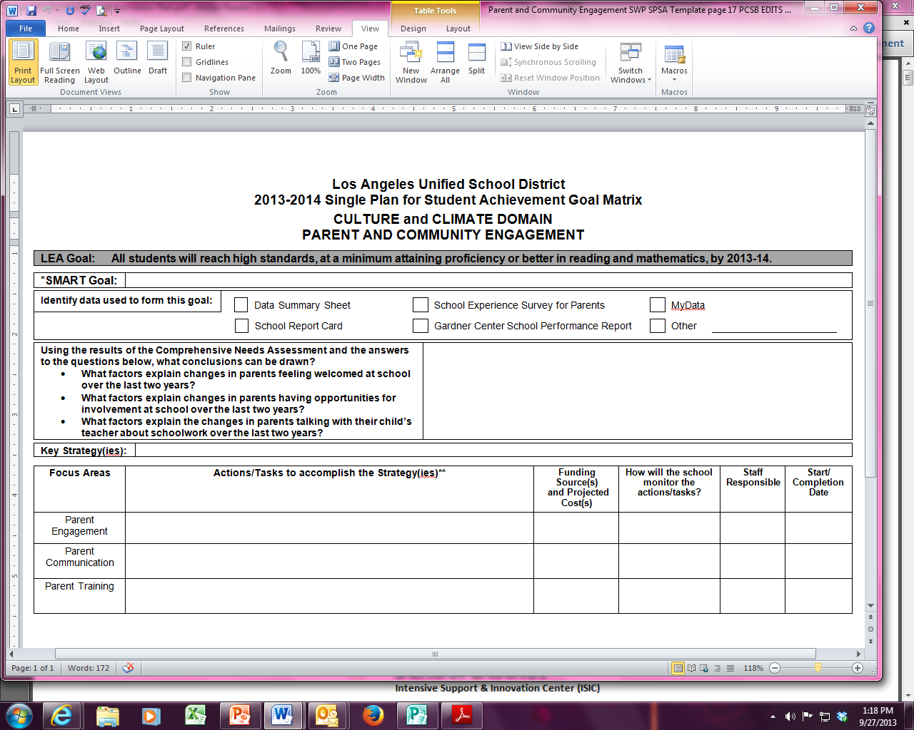
19
Sample SPSA Page
Notes:
Say:
“This is a sample page from the Culture and Climate Domain for how schools engage parents and the community. [Click] There are pages in the SPSA for English Learners, mathematics and English Language Arts, too.
In gray is the LEA, or District, goal. [Click]
Next is the school’s goal. [Click] SMART stands for: Specific, Measureable, Attainable, Relevant, and Time-Bound.
Once you have made your goals, this sheet calls for specific strategies that can be implemented to achieve that goal. [Click]
Finally, the school writes the actions and tasks it will complete [Click], including the person or persons responsible.”
[Click]

Slide 20
20
Step 4
Define Timelines, Personnel Responsible, Proposed Expenditures, and Funding Sources to Implement the Plan
For each Goal, defined Strategies and Action Steps/Tasks must be set as measures of progress.
Be specific about the person(s) responsible and completion deadlines.
Provide supplemental services only—do not allocate funds to pay for what could, or should, be provided with general funds.
Source:
Guide to the Single Plan for Student Achievement
California Department of Education, February 2013
Notes:
Say:
“After you have identified your goals, you will want to break them down into specific strategies, action steps and/or tasks to help make progress toward that goal.
You will want to be as specific as possible to ensure that everyone is clear about individual responsibilities.
Also note that whenever considering purchasing any materials or personnel time, the funds must be spent on services that are supplemental, not in place of what can be purchased with general funds.”
[Click]

Slide 21
21
Step 5
Recommend the SPSA to the Local Governing Board
The governing board wants
assurance that the SSC has
addressed its legal
responsibilities through:
proper constitution
evidence that input has been sought from stakeholders
a tailored Single Plan based on student need
a formally approved the plan
Source:
Guide to the Single Plan for Student Achievement
California Department of Education, February 2013
Notes:
Say:
Earlier, it was mentioned that the local governing board for LAUSD is the Board of Education.
The State regularly conducts audits of school documents directly related to Title I. FSEP looks for [Click] proper constitution of the SSC,
[Click] evidence that stakeholder input was solicited, [Click] the Plan is tailored to student need as assessed by the school’s data, and [Click] that the plan has been formally approved.”
[Click]

Slide 22
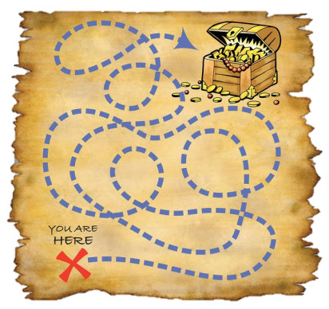
22
Step 6
Implement the Plan
The site administrator is responsible for implementing and evaluating the activities outlined in the plan.
This may include:
assigning, directing, and
supervising responsible staff
purchasing materials and equipment
accounting for allocated funds
Source:
Guide to the Single Plan for Student Achievement
California Department of Education, February 2013
Notes:
Say:
“The site administrator, usually the Principal, is responsible to implement the plan, as well as be a part of its evaluation of effectiveness. The principal [Click] assigns, directs, and supervises responsible staff in the implementation of the plan. The principal also is responsible for [Click] all purchases and accounting, or the keeping of records of purchases.”
[Click]

Slide 23
23
Step 7
Monitor Implementation
Clear timelines with tasks, and persons responsible make monitoring much easier.
A plan that is too general runs the risk of diminishing student achievement results.
As the implementation of the plan unfolds, the SSC should evaluate the progress of each major strategy for identified students and share this information with stakeholders.
Source:
Guide to the Single Plan for Student Achievement
California Department of Education, February 2013
Notes:
Say:
“The best way to monitor the implementation of the plan is with a clear timeline including a well-defined task and the staff person(s) responsible for getting completing it.
Plans that are too general or vague are not easy to follow, leave implementation open to interpretation, and are easily put on the back-burner.
Take time at every SSC meeting to review the goals and report on the progress of each strategy to meet that goal.”

Slide 24
24
Continue the Cycle
At least annually, the SSC must evaluate the effectiveness of planned activities. SSC meeting minutes should reflect the evaluation.
In the cycle of continuous improvement of student performance, evaluation of the results of goals will provide data for the following year’s plan.
Source:
Guide to the Single Plan for Student Achievement
California Department of Education, February 2013
Notes:
Say:
“The Single Plan should be reviewed by the SSC at least annually to see if it is effectively meeting the needs of students.
From data analysis to monitoring the effectiveness of the Plan, the cycle of continuous improvement is refreshed by the analysis of new student data, which drives the next year’s plan.”
[Click]

Slide 25
25
Objective #4
Guidelines for Conducting SSC Meetings
Notes:
Say:
“The fourth objective is to provide information and tips on conducting SSC meetings.”
[Click]
Say:
“Now, let’s do a short activity to activate some prior knowledge about the roles and responsibilities of SSC Officers. (SEE HANDOUT “Whose Responsibility Is It?”)

Slide 26
26
SSC Chairperson
The SSC Chairperson…
follows the order of posted agenda, clearly announcing transitions and items
enforces policies relating to the conduct of meetings and helps ensure compliance with the bylaws
recognizes people who desire to speak, and protects from disturbance or interference
redirects discussion to the question when a motion is before the Council
explains what the effect of a motion would be if it is not clear to every member
provides leadership on behalf of the Council and the community it serves
calls the meeting to order and closes meeting at the appointed time
Notes:
Say:
“We will start with who conducts the meeting: the Chairperson. [Click]
The Chair provides leadership. This means that he or she presides over the meetings and clearly communicates the purpose and work of the SSC.
[Click]
The Chair also calls the meeting to order on time and helps to keep all members on track in order to close on time.
[Click]
It is also the responsibility of the Chair to know and enforce any SSC bylaws. And…
[Click]
to follow the posted agenda. By clearly announcing each item on the agenda and each motion’s result, the Chair assures that each member, and any visiting public, can track the meeting’s progress.
[Click]
The next responsibility of the Chairperson is to recognize people who would like to speak, while also protecting the meeting from interference. The Chair does not take sides. He or she “passes the gavel”, meaning excuses his or herself from the responsibilities of Chair when taking a position or speaking on a matter.
[Click]
It is the Chair’s responsibility to explain the effect of each motion, clarifying ambiguity. Before voting, the Chair restates the motion so everyone is clear about what is being voted on.
[Click]
Finally, it is the Chair’s responsibility to redirect discussion back to the question when a motion is before the Council. He or she may have to ask colleagues to refrain from sidebar, or otherwise off-topic, discussion.”

Slide 27
27
Essentials
Post the agenda 72 hours in advance (or 24 hours in advance in the case of an emergency meeting), specifying the date, time, location, and each item of business, especially if an action (vote) will be taken (Greene Act)
Agenda must be posted inside and outside of the building where the meeting will take place in view of the public (Greene Act)
Create sign-in sheets showing identification of stakeholders and officers
Have all materials translated and interpretation service requested (Ed Code 48985)
Have enough copies of the meeting materials available for the public upon request (Greene Act)
Read/be familiar with SSC bylaws
Notes:
Say:
“Most Uniform Complaint Procedures (UCPs), which are formal, documented complaints, are filed on these issues. For this reason, these are essential actions to master.
[Click] [Click]
It is the school’s responsibility to post the agenda, clearly in view of the public, 72 or 24 hours in advance of a meeting. This gives members of the community the opportunity to attend if they wish to. SSC meetings are considered “open” meetings to the public, because the SSC is governed by the Greene Act.
[Click]
Creating sign-ins with all stakeholder groups (teachers, parents, students, etc.) identified, [Click] providing translation, and [Click] having enough copies of the agenda and handouts to contribute to a welcoming environment. These essentials should not be overlooked.
[Click] Also, be familiar with the bylaws. Middle schools, for example, may be surprised to know that their bylaws can exempt students from membership on the SSC, which is not the case with the standard district bylaws for secondary schools. Often, people file complaints when members of the Council violate bylaws.”

Slide 28
28
Essentials
Follow the posted agenda, being sure to identify which items need action (a vote) (Greene Act)
  Exception: If an action is needed and was not known at the time the agenda was posted, the SSC may, by unanimous vote, add the item on the agenda for action
Follow agreed-upon operating procedures, clarifying with the Parliamentarian when necessary (e.g. Robert’s Rules of Order, LAUSD Operating Norms and Code of Conduct)
Do not alter minutes after the Council has approved them, making them an official record of the meeting
Allow the public to address the Council on any matter within the jurisdiction of the Council during the Public Comments section of the agenda (Greene Act)
Notes:
Say:
“During the Federal Program Monitoring audit, which is conducted at randomly selected schools every 2 years, the auditors are looking for good documentation of meetings. They want to see:
agendas with items discussing aspects of the SPSA, with time during the meeting to get input from the public,
minutes which reflect all stakeholders were present and gave input according to procedure,
and voting to spend money on items which will directly serve students in accordance with the Single Plan.
Minutes and agendas become official records of what transpired at each SSC meeting, so it is very important that the original documents of each meeting be kept at the school. It is highly suggested that officers meet at the end of each meeting to plan agenda items for the next one.”

Slide 29
29
Conducting the Meeting
Call to Order
The meeting is first called to order. Second, members are welcomed. Next, roll call is taken. Finally, quorum is/is not established.
    Quorum is the number of members that must be legally present in order to conduct business, 50% of the membership total + 1 member
If a quorum is not present, the Chair waits until there is quorum, or until after a reasonable time, there appears to be no prospect that a quorum will assemble.
If quorum cannot be obtained, the Chair calls the meeting to order, announces the absence of a quorum, and entertains a motion to adjourn, recess, or have an informational meeting.
Notes:
Say:
“The Chair first calls the meeting to order, then welcomes the members. Next, roll to be taken to determine if quorum has been met. [Click] Quorum is defined as 50% of the membership plus 1 member.
Why is it so important? Well, we don’t want small, underrepresented groups making decisions for the entire group. Representative membership will improve representational voting results.
[Click]
If a quorum is not present… (read bullet point)
[Click]
If a quorum cannot be obtained… (read)”
[Click]

Slide 30

30
Conducting the Meeting
Motions
Matters/Issues must be considered in order.
Two types of motions: main and subsidiary. Both motions need a “second.”
After a motion’s first reading, the Chairperson should inquire, “Is there any discussion?”
The maker of a motion has the first right to speak and to amend it.
Main motion: brings business before the assembly. Main motions can only be made when no other motion is pending and must be directly related to the issue under consideration.
Subsidiary motion: assist in considering or rejecting a main motion (e.g. motions to postpone, refer to committee, table). Subsidiary motions must directly relate to the main motion.
Notes:
Say:
“As was mentioned earlier, agenda items must be addressed in the order listed on the agenda, unless a motion is approved to reorder the agenda for a good reason. When members would like to take action on an issue or matter, they make a motion, saying “I motion to…”
Two types of motions are [Click] main motions: which are made when there are no other pending motions. And [Click] subsidiary motions: which support or reject the main motion. Examples of subsidiary motions are: to postpone, table, or refer to a committee.
A “real life” example of a main motion is when a member makes a motion to purchase intervention materials. A subsidiary motion, to only purchase materials for third and fourth grade, might be made to amend the main motion.
(Read last two bullet points.)

Slide 31
31
Conducting the Meeting
Voting
Agenda needs to indicate when an action/vote will occur, prior to posting of the agenda
Chairperson should
clearly announce the
results of the voting
Minutes should reflect number of votes in favor, against, and abstentions
A tie vote is a “lost” vote because no majority was obtained
Notes:
Say:
“In addition to making motions, SSCs “take actions”, or vote, to make decisions.
[Click] 72 hours prior to the meeting, the posted agenda should indicate clearly that an action or vote will occur.
[Click] It is the Chair’s duty to announce the results of the voting. This practice not only clearly communicates the results but gives the secretary a chance to take accurate notes.
[Click] We cannot stress enough the importance of keeping accurate minutes. The secretary should note the outcome of each vote, including those in favor and those against.
[Click] If voting ends in a tie, it is considered a “lost” vote, because no majority was obtained.”

Slide 32
32
After the Meeting
Complete signed and dated minutes within a week of SSC approval
Maintain all records for 5 years
Furnish copies of meeting minutes or any other Council document to members or the public upon request (Greene Act)
Determine next meeting’s agenda items
Members take collective responsibility for their performance
Notes:
Say:
“After the meeting, there are a few essential housekeeping items that must be addressed.
Within a week of the meeting, publish and distribute the minutes. It is essential that you maintain official records of the meeting, including minutes, sign-ins, agendas, and any handouts or flyers distributed. These documents are thoroughly examined during the FPM visits and are used as evidence when complaints are filed.
If members of the public wish to see meeting minutes or any other Council document, furnish these in a reasonable timeframe.
Finally, officers should meet to determine the agenda items for subsequent meetings.
Remember that the membership takes collective responsibility for the decisions made in SSC. This means that members are expected to support all motions which pass, regardless of whether they voted for or against.”
[Click]

Slide 33
33
3-2-1
What are 3 things have you learned?
What 2 ideas do you have about your specific officer role?
What is 1 goal do you have for SSC this school year?
Notes:
Say:
“As a closing activity, we would like you to consider THREE things you learned today, TWO things you learned about your specific officer role, and ONE goal you have for School Site Council this year.
Take 3 minutes to think and write down your ideas.”
[After 3 minutes have passed]
Now please share at your table your learning and goal.”
[Click]

Slide 34
34
We thank you for participating!
Notes:
Say:
“Thank you for actively listening and participating in this training. We hope that you found it informative and useful.”

